Slide 1

Analysis On YouTube Channels

Slide 2



Objectives and Work flow
Workflow:

Slide 3
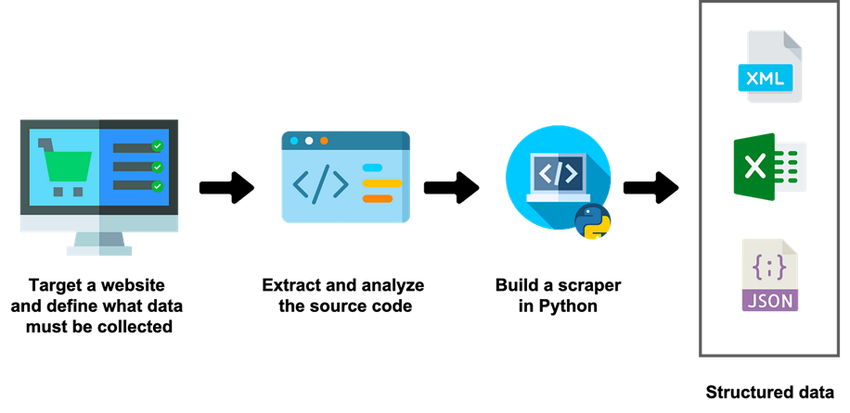
Extracting the Data from website
•Web Scraping is a technique to extract a large amount of data in human readable format from websites.
•Web Scrapping extracts the data from websites in the unstructured format (HTML /XML or any other format)
•Beautiful Soup is used extract information from the HTML format and XML files.
.

Slide 4
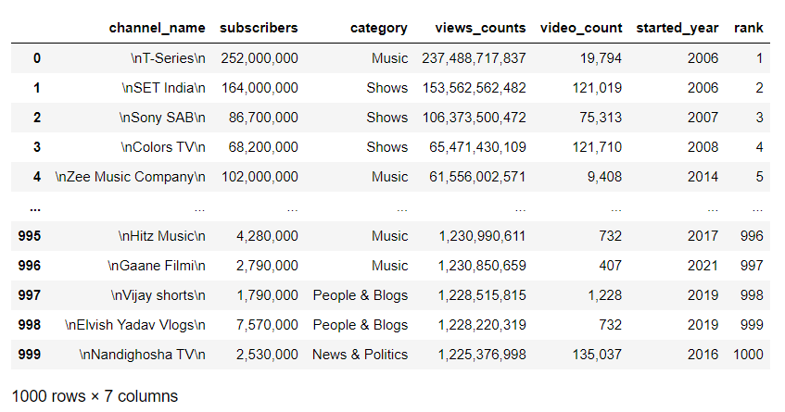
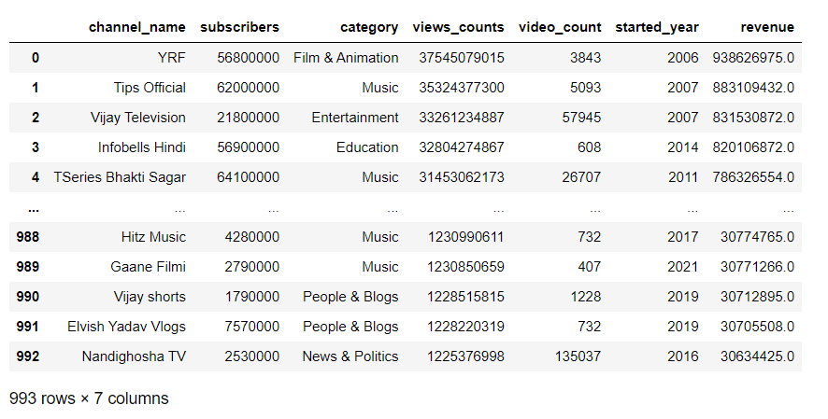
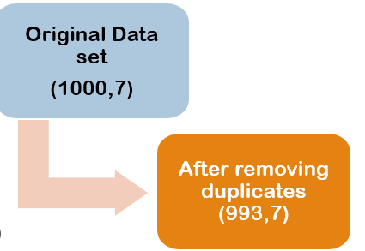
Dataset
Raw Dataset After Scrapping
Dataset After Cleaning

Slide 5
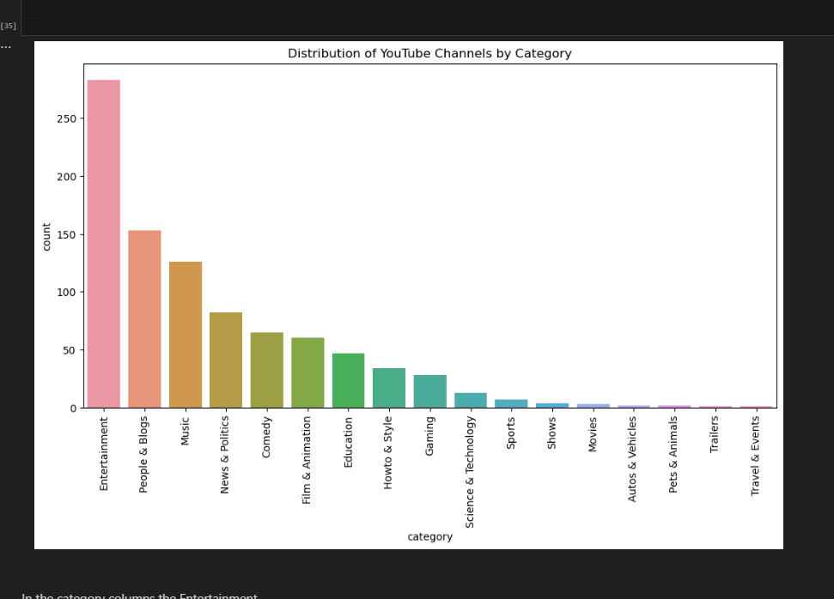

Distribution of Youtube Channels by Category
Top Categories based on no. of channels:
Entertainment
People and Blogs
Music
Best earning category

Slide 6
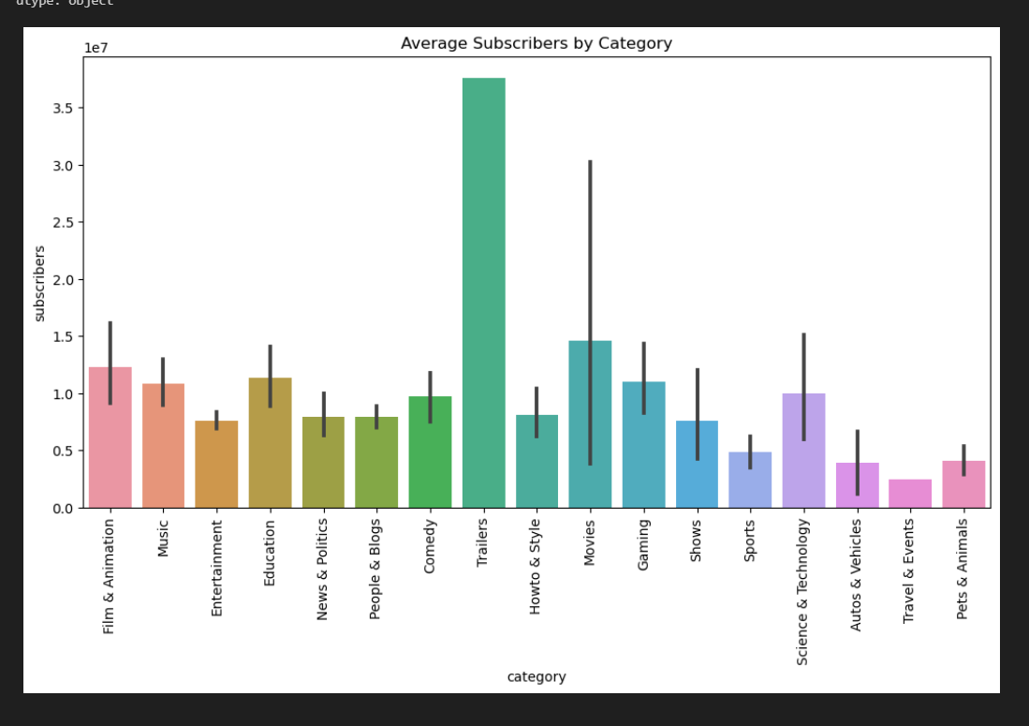
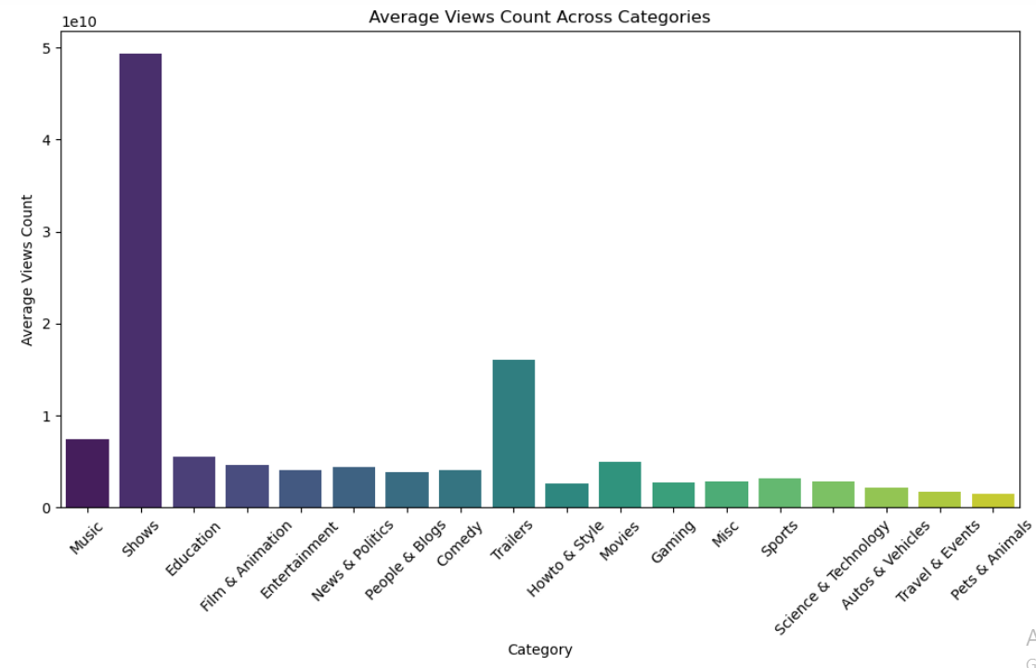
Category vs Subscribers
Category vs Viewcounts
Top Categories based on No. of Views:
Trailers
Movies
Shows
Education
Top Categories based on No. of Subscribers:
Trailers
Movies
Science & Technology
Film and Animation

Slide 7
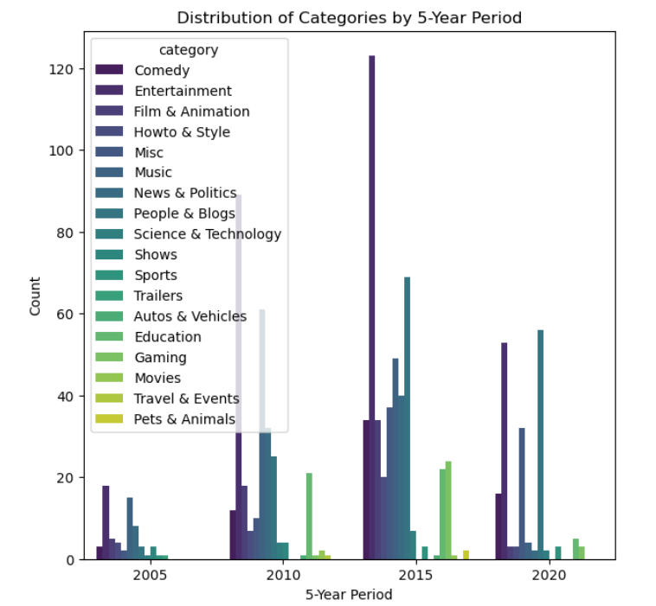
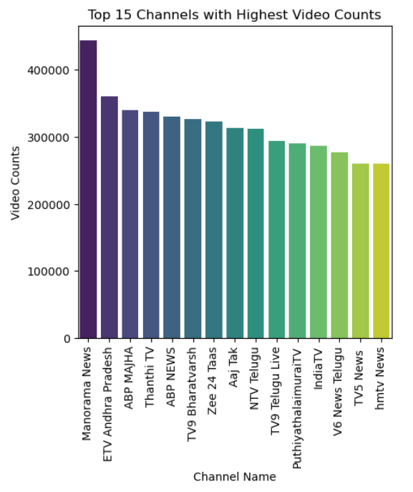
Categories by 5 Year Period
Top 15 Channels
Educational Channels got into picture mostly between 2010-2015 and got reduced after 2020.
Entertainment Channels number got reduced from 2015-2020.
Travel and Events got popular after 2015.
Top Channels with Highest videos counts – News channels

Slide 8
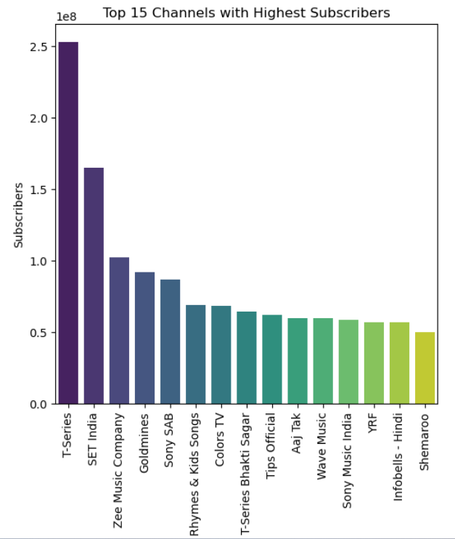
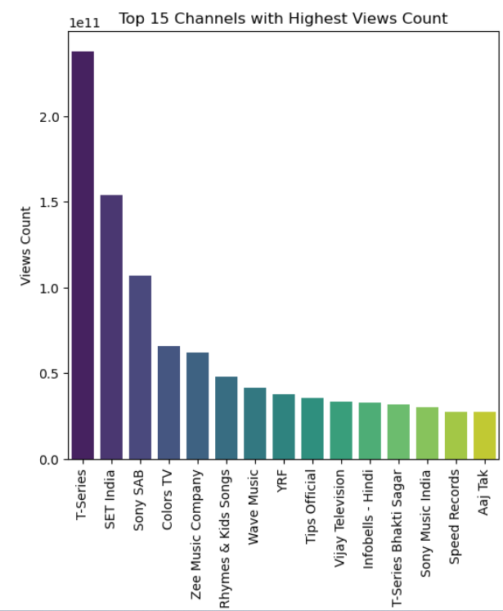
Highest Subscribers/ Views count : Music channels, Kids channels

Slide 9
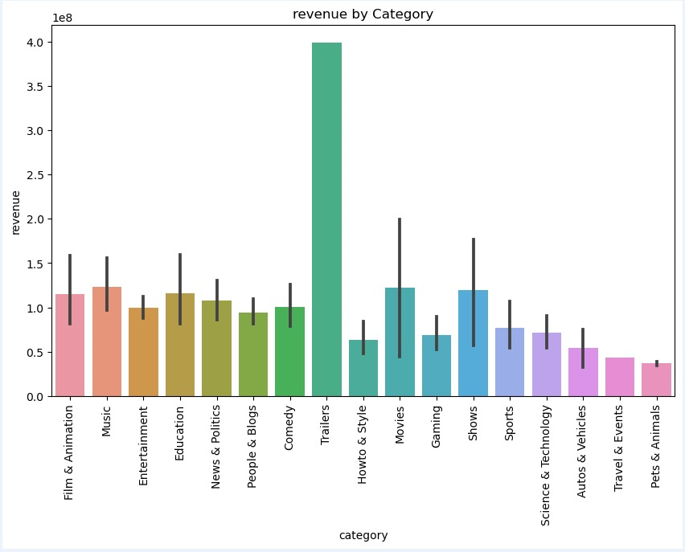
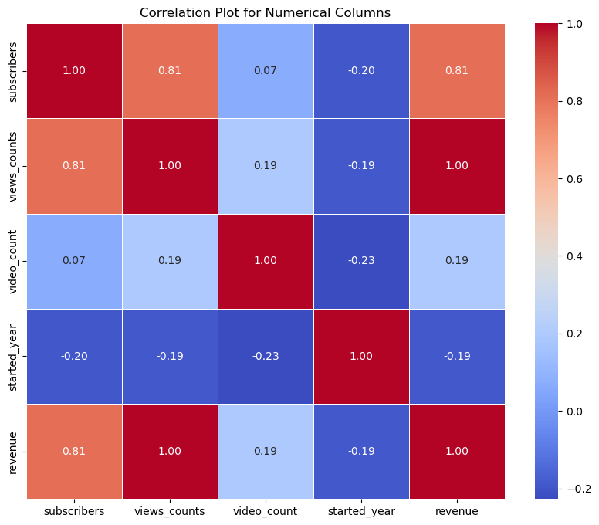
Top Earning Categories:
Trailers
Movies &shows
Education
No of Views per video is the main deciding factor for revenue
Other factors which are not considered in analysis due to data collection constraints:
Geography
Ads and sponsorships
Engagement and watch time
Premium subscriptions
Monetization Programs

Slide 10
Conclusions
Website:- https://pl.youtubers.me/india/all/top-1000-youtube-channels-in-india
Revenue Depends on several Factors:
Category of the channel
YouTube monetization Programmes
Demographic features
No. of views
No. of subscribers
Highly correlated factors: (Subscirbers, Views_count), (Views_count, revenue)
Educational Channels got reduced may be because of saturation or due to raise in EdTech companies.
Travel blogs got a hype after 2020.
The categories with possibility of better revenue generation:
Kids and Rhymes
Music shows & Entertainment

